Slide 1
Implementare una strategia serverless di Data Analytics con Microsoft Azure
Roberto Freato

Slide 2

once upon a time, there was
A business intelligence team performing analysis and getting out insights
An entire company depending on those insights
A small but amazing dev/tech team in charge to build data stuff to do it
We didn’t know how fast would grow up
Didn’t want to overengineer
Didn’t know what a Data Platform was, either
Can you read this line?

Slide 3
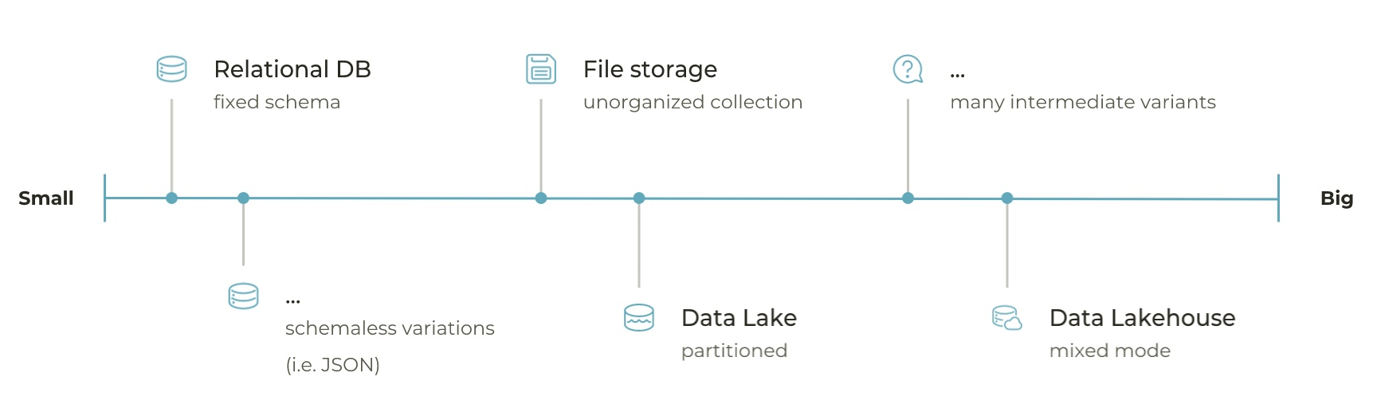
how we evolved and scaled the Data Platform
App Service
Batch
Container Instances
Container Apps
Even in the back seats?

Slide 4
some glossary
Data Movement
Data Platform
Landing Storage
Big Data
Spark
Sourcing
Ingestion layer
Data Engineering
Databricks
Cloud
And now?

Slide 5
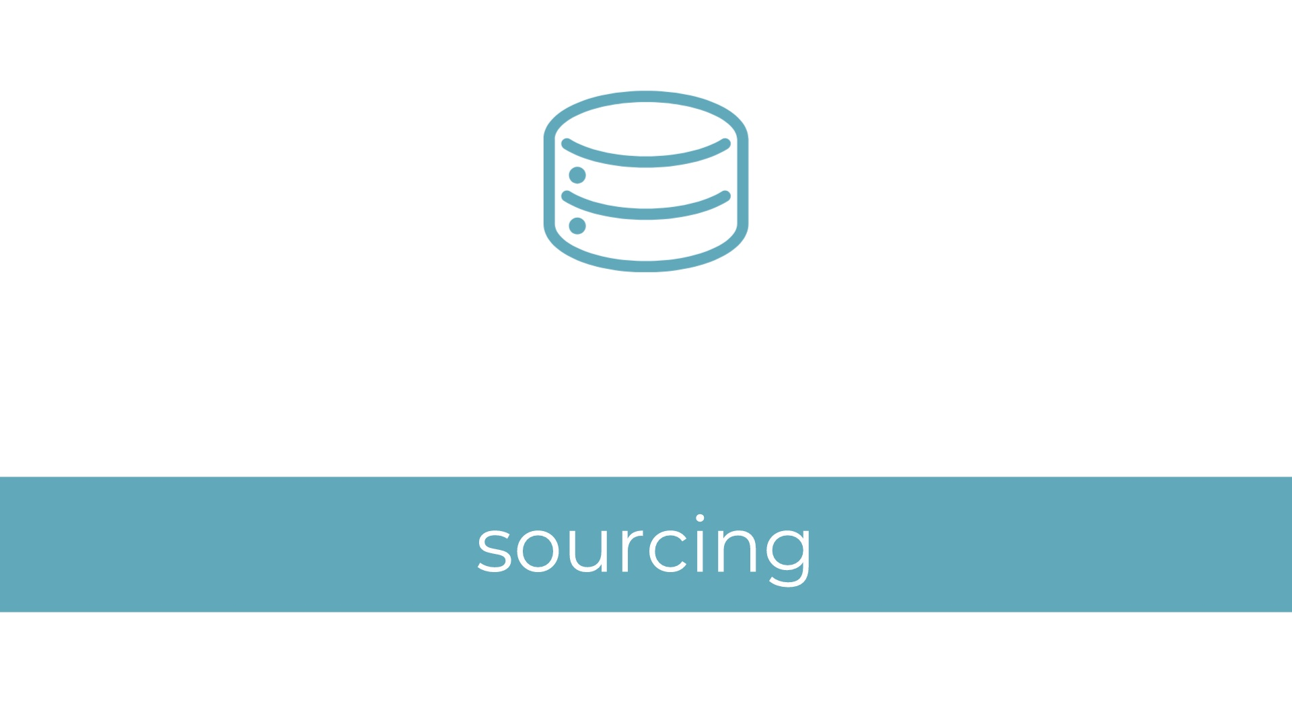

Slide 6
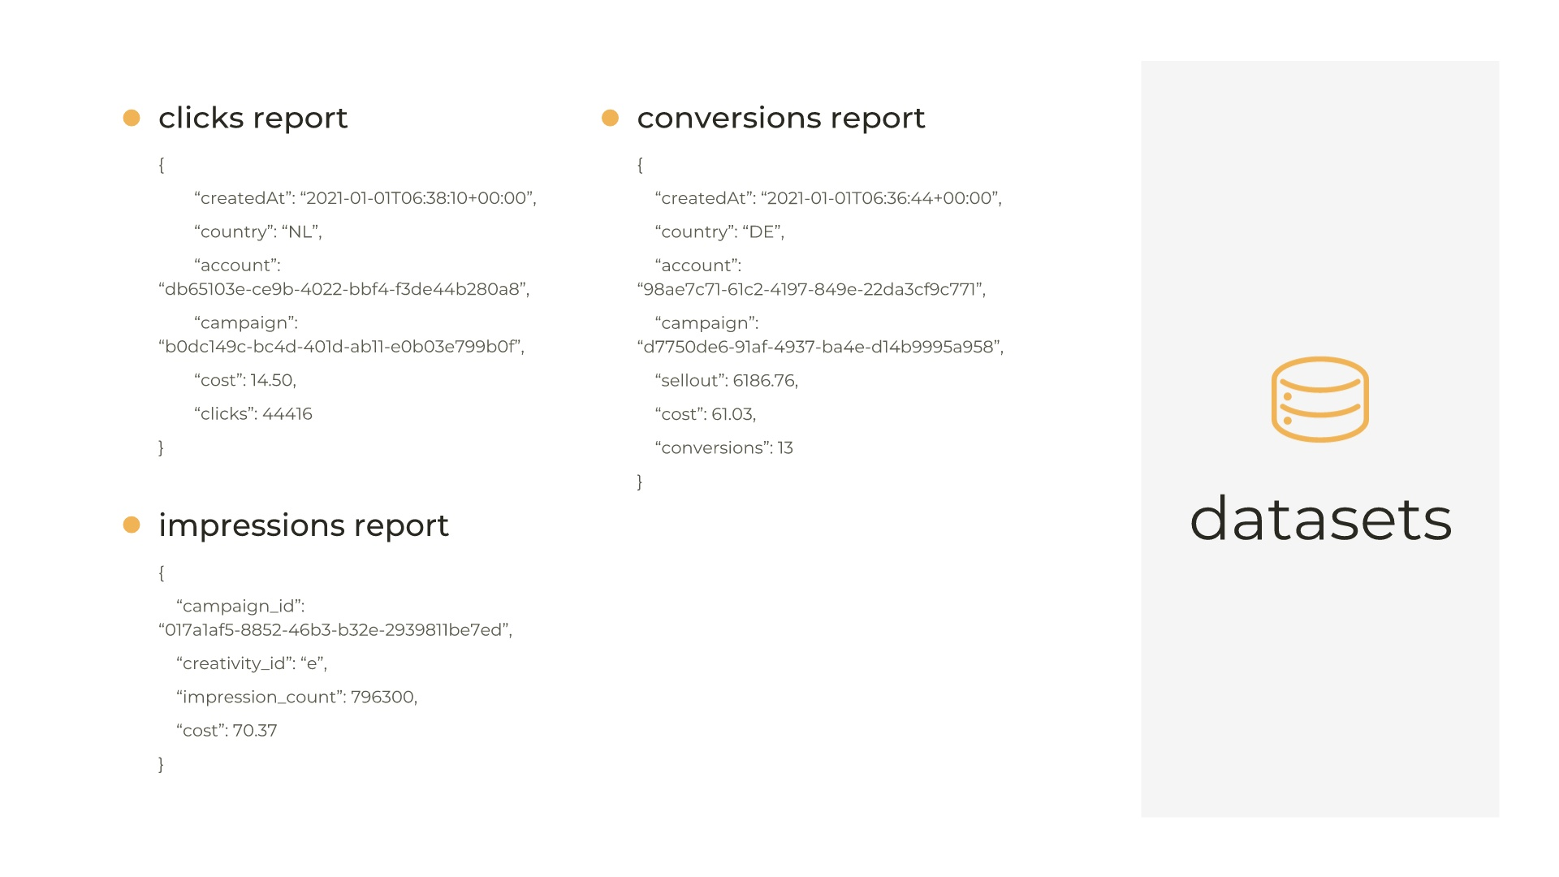

Slide 7
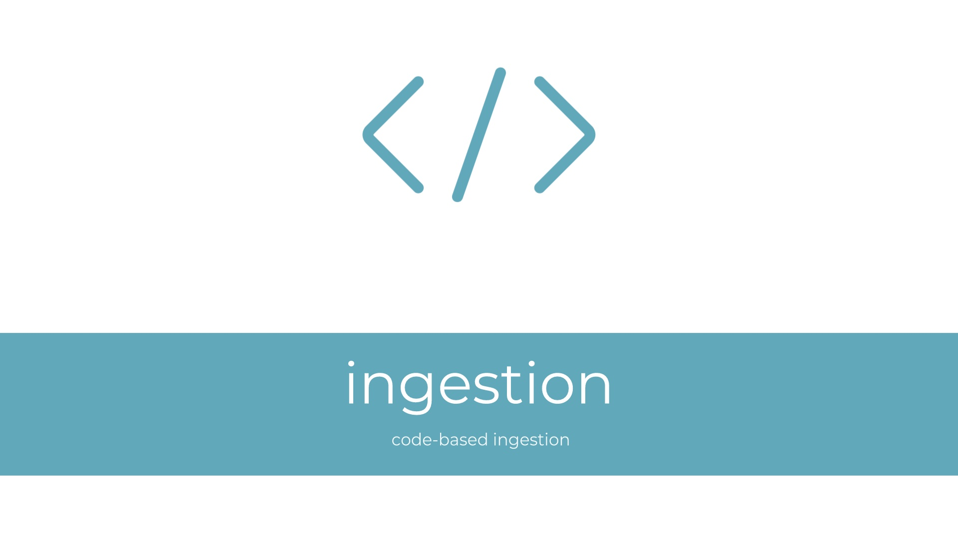

Slide 8
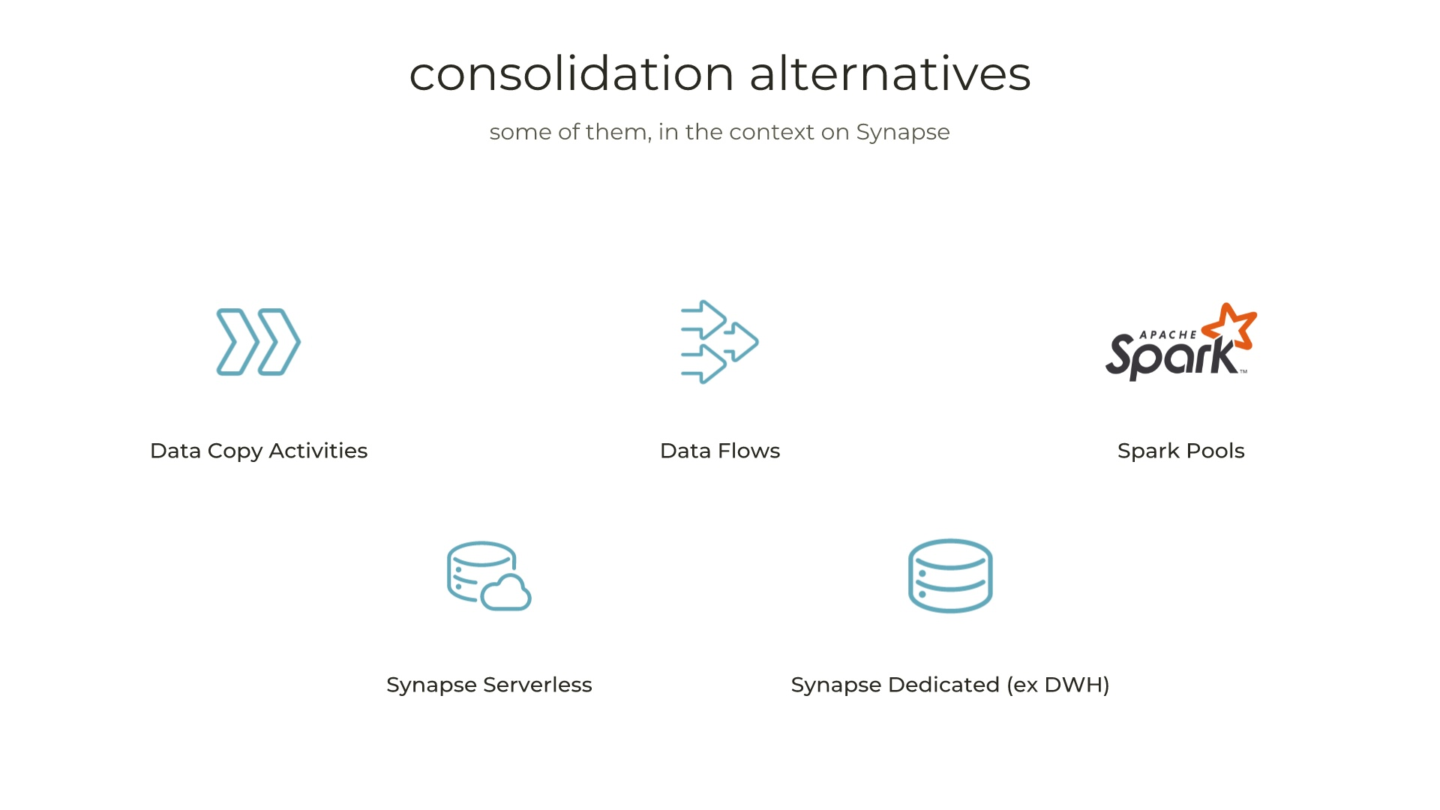

Slide 9
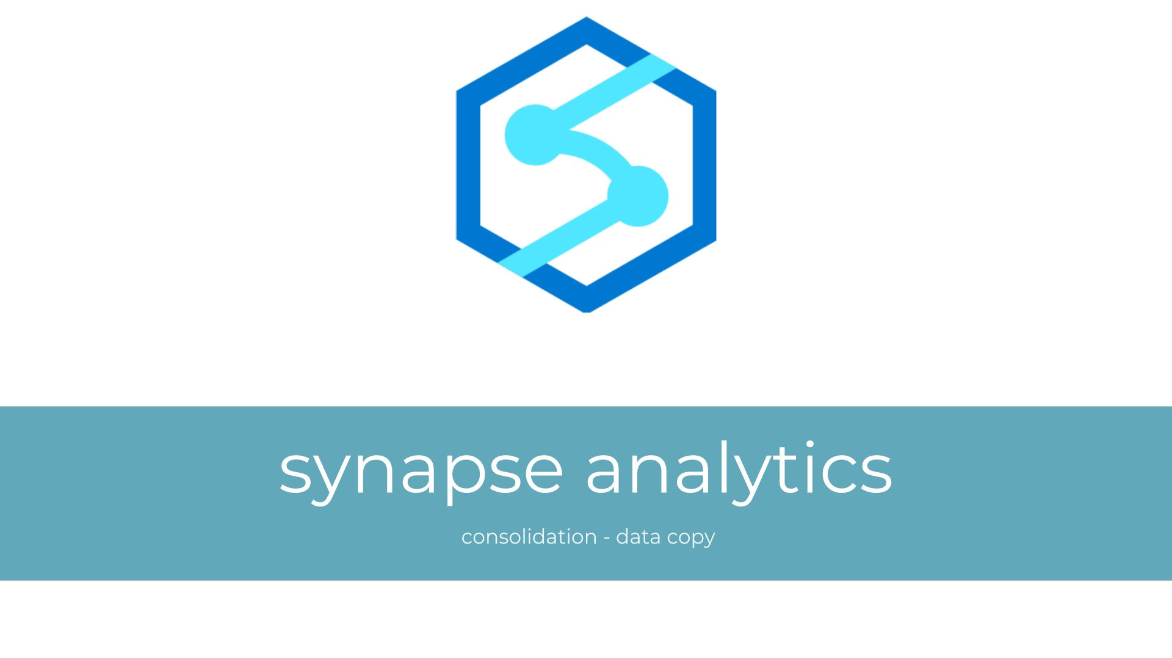

Slide 10
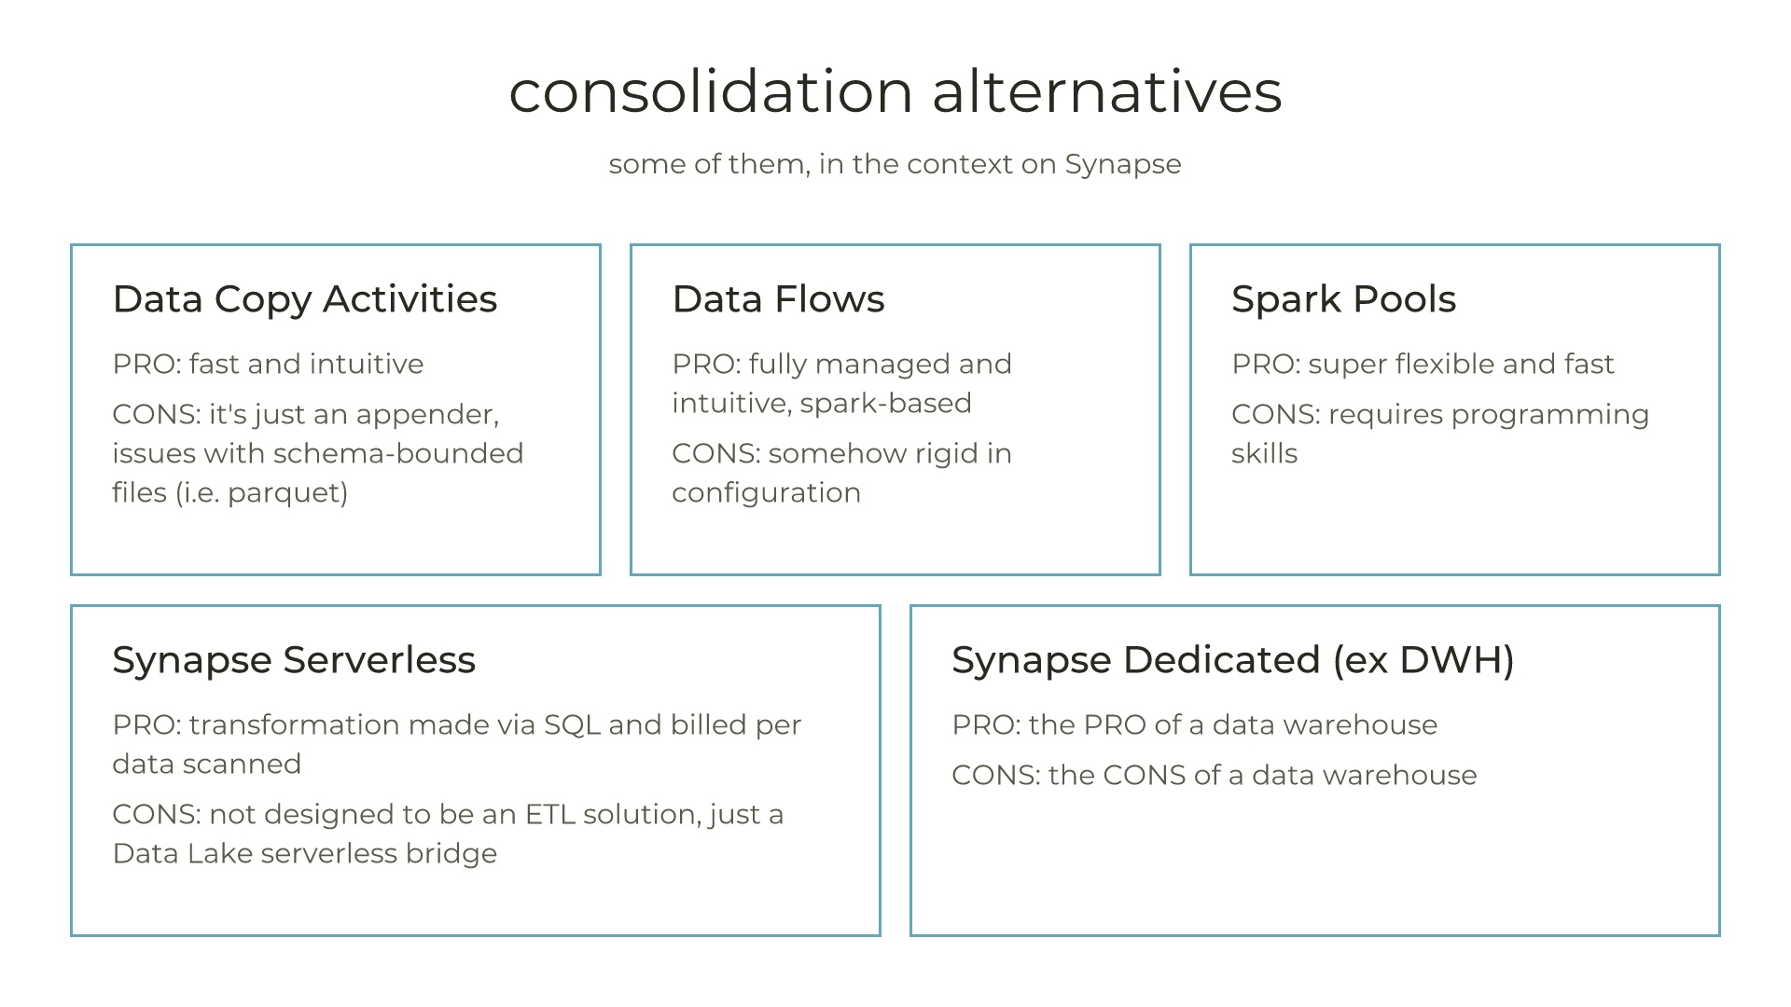

Slide 11
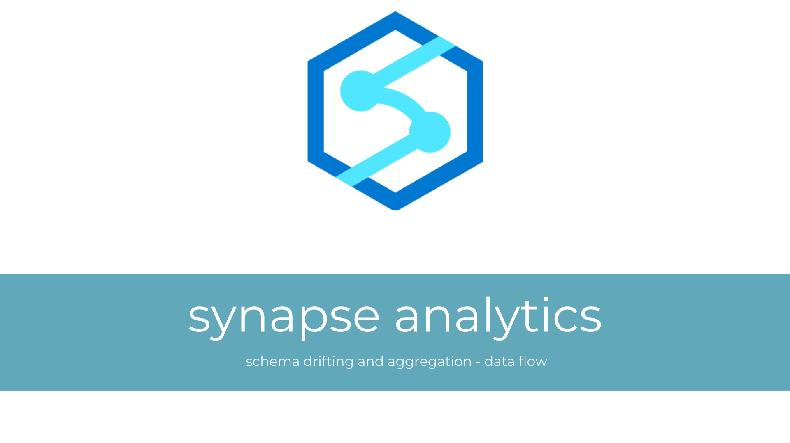

Slide 13


Slide 14
how we evolved and scaled the Data Platform
App Service
Batch
Container Instances
Container Apps
Even in the back seats?

Slide 15
